Slide 1
School Integration of Syrian Refugee Children in Turkey
Murat Güray Kırdar ^{ͱ}, İsmet Koç# and Meltem Dayıoğlu^{ɫ}
^{ͱ} Department of Economics, Boğaziçi University, Bebek, Istanbul 34342, Turkey e-mail: murat.kirdar@boun.edu.tr.
# Institute of Population Studies, Hacettepe University, Ankara, 06800 Turkey, e-mail: iskoc@hacettepe.edu.tr
^{ɫ} Department of Economics, TED University, Ankara, 06420, Turkey, e-mail: meltem.dayioglu@tedu.edu.tr

Slide 2
What we do
We document the differences in schooling outcomes of native and refugee children and seek to understand the underlying causes of these differences.
We analyze several schooling outcomes, including enrollment status, ever attending school, grade for age, as well as school performance indicators, such as progressing, repeating, and dropping out conditional on enrollment.
We also examine children’s employment and marriage outcomes to better understand the observed patterns in schooling outcomes.

Slide 3
Data
Turkey Demographic and Health Survey (TDHS). For the first time in 2018, the TDHS included a module (TDHS-S) to collect information on Syrian refugees in Turkey.
Both the TDHS and TDHS-S collect rich information on sample households’ demographic and socioeconomic characteristics, including children’s schooling.
In addition, both the TDHS and TDHS-S are representative of their respective populations.
Our main target group is school-aged children.
Considering late school entry for both Turkish and Syrian children, we restrict the sample to 7–17-year-olds.
7,219 children in the Turkish sample and 3,010 children in the Syrian sample

Slide 4
Summary of Key Findings
Accounting for a rich set of socioeconomic variables, we find that the native–refugee gap in school enrollment drops by half for boys and two-thirds for girls, but the gap persists for both genders.
When we restrict the sample to refugees who arrived in Turkey at or before age 8 and account for socioeconomic differences, the native–refugee gap completely vanishes for both boys and girls, indicating that school integration of refugee children in Turkey has been possible conditional on their age at arrival.
We also find that the timing of boys’ school dropouts coincides with their entry into the labor market, whereas girls’ dropouts mostly occur before marriage age.
Finally, we document important differences between natives and refugees, as well as early and late arrivers among refugees, in never starting school, grade progression and repetition, dropping out, and grade for age.

Slide 5
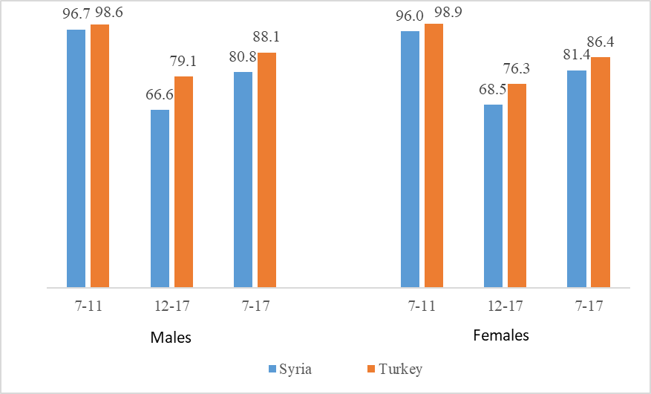
Pre-war Period School Enrollment Rates of Syrian and Turkish Children by Age and Gender, SFHS-2009 and TDHS-2008

Slide 6
Initially, refugee children attended schools set up at the initiative of camp administrators. These camp schools were later turned into Temporary Education Centers (TECs) and established in off-camp areas as refugees gradually moved out of camps.
Starting with the 2014–2015 school year, Syrian refugee children were accepted into Turkish public schools.
The latest statistics from the Ministry of Education of Turkey (MoNE) indicate that over a third of school-aged Syrian children are not attending school (MoNE, 2021a).
While 41% of Syrian children were enrolled in the 2014–2015 school year, and this rate increased to 64% in the 2020–2021 school year.
The most significant improvement was at primary and middle school levels, where the enrollment rate reached nearly 80%; however, enrollment remained low at 39% at the high school level.

Slide 7
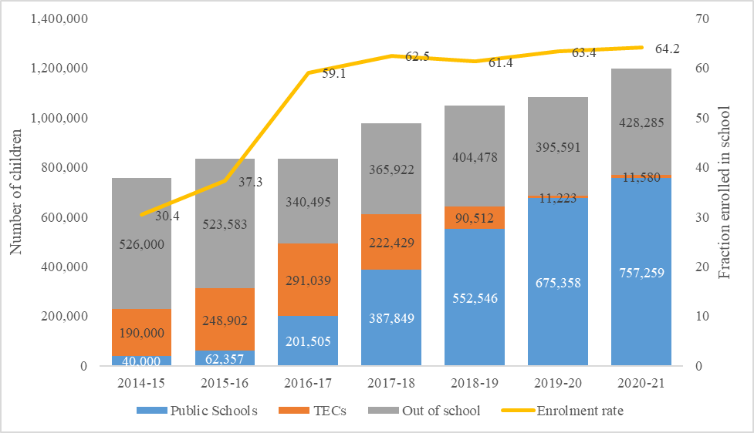
Number of Syrian Students in TECs, Public Schools and Out-of-School Children, and School Enrolment Rates

Slide 8
A) School Enrollment by Native-Refugee Status and Gender

Slide 10
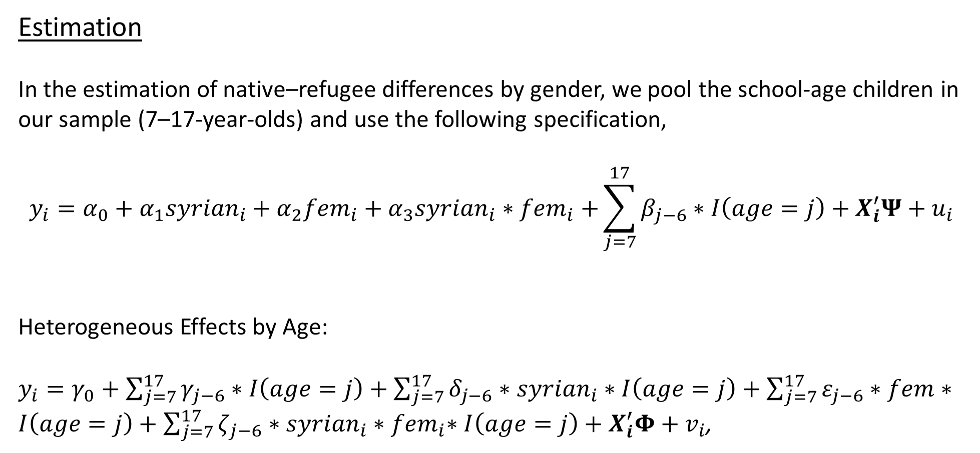
Estimation
In the estimation of native–refugee differences by gender, we pool the school-age children in our sample (7–17-year-olds) and use the following specification,
$$y_{i}=α_{0}+α_{1}{syrian}_{i}+α_{2}{fem}_{i}+α_{3}{syrian}_{i}{∗fem}_{i}+\sum_{j=7}^{17}{β_{j−6}}∗I\left(age=j\right)+X_{i}^{′}Ψ+u_{i}$$
Heterogeneous Effects by Age:
$y_{i}=γ_{0}+\sum_{j=7}^{17}{γ_{j−6}}∗I\left(age=j\right)+\sum_{j=7}^{17}{δ_{j−6}∗{syrian}_{i}}∗I\left(age=j\right)+\sum_{j=7}^{17}{ε_{j−6}}∗fem∗I\left(age=j\right)+\sum_{j=7}^{17}{ζ_{j−6}}∗{syrian}_{i}{∗fem}_{i}∗I\left(age=j\right)+X_{i}^{′}Φ+v_{i}$,

Slide 13
Refugee-Native Differences in Predicted Enrollment

Slide 14
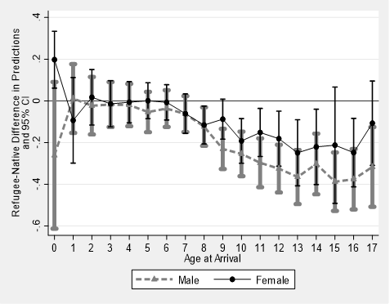
A1) Difference in Enrollment by Age at Arrival

Slide 15
B1) Difference in Enrollment by Years in Turkey

Slide 16
Understanding school enrollment gaps in the context of child labor and marriage

Slide 20
Other schooling outcomes, including performance indicators

Slide 23
Conclusion
A significant fraction of native-refugee differences in school enrollment (about half for boys and two-thirds for girls) can be explained by differences in socioeconomic characteristics between Syrian and Turkish households.
A key finding is that once we restrict the refugee sample to children who have arrived in Turkey at or before age 8 and account for the socioeconomic differences, the native–refugee gap completely disappears both for boys and girls.
We also find a strong association between the timing of school dropouts and the timing of labor market entry among refugee boys, suggesting that these decisions are driven by a similar set of underlying factors.

Slide 24
The native-refugee differences in school enrollment essentially stem from refugees’ higher propensity for never enrolling in school. When we control for the socioeconomic differences between refugees and natives, refugees are, on average, no more likely to drop out than natives once they are enrolled in school.
In terms of school performance, conditional on enrollment, refugee boys fall behind native boys, although they are a more select group due to their lower enrollment rates.
Policy Implications:
Targeted program for children arriving at older ages
Improving refugee households’ income and living conditions would help improve children’s school outcomes

