Slide 1
Mother’s Education and Early Childhood Educational Care
Betul Akar TUBITAK | Pelin Akyol Bilkent University | Cagla Okten Bilkent University
SEVENTH ANNUAL ISTANBUL MEETING ON HUMAN CAPITAL
October 19, 2023

Slide 2
MOTIVATION:
Early childhood care and education has crucial impact on children’s educational and labor market outcomes.
  (Heckman, 2006; Francesconi and Heckman, 2008; Heckman, Moon, Pinto, Savelyev, and Yavitz, 2010; Barnett and Masse, 2007; Reynolds, Temple, Suh-Ruu Ou, Arteaga, and White, 2011; Garcia, Heckman, Leaf, and Prados, 2016; Heckman and Karapakula, 2019)
According to UNICEF report (2019),
  In 2017, more than 175 million children, nearly half of all pre-primary-age children in the world, are not enrolled in the pre-primary education.
  In 2018, in high-income countries, 83 percent of children are enrolled in the pre-primary education, whereas in low income countries 22 percent of children are enrolled.
  Of the 31 countries with the lowest pre-primary enrolment rates, 29 are low or lower-middle-income countries.
What could be another way of improving children’s development in the early childhood?

Slide 3
RESEARCH QUESTION
How does maternal education affect early childhood care?
We investigate the impact of the extension of mandatory education from five to eight years in Turkey on activities that are considered to be primary components of early childhood education and care, namely time spent in reading to children, playing with children, and talking to children for mothers who have at least one child aged 0-2.

Slide 4
BACKGROUND:
1997 Compulsory Schooling Reform
Prior 1997, basic education in Turkey composed of compulsory five years of primary school and voluntary three years of middle school.
1997 Compulsory Schooling Reform extended mandatory education from 5 years to 8 years.
The exposure to the reform depends on school starting age:
  Individuals born before 1986 could drop out after they complete five years of primary school.
  Individuals born after 1986 had to complete five years of primary school and three years of middle school.
1997 Compulsory Schooling Reform did not improve the quality of public-school educations; however, the compulsory schooling law had an outstanding impact on middle school enrollment rates.
1997 Compulsory Schooling Reform is well-established and highly used instrument for education.

Slide 5
RELATED LITERATURE
The literature has documented the importance of parental child care in the development of children’s cognitive and non-cognitive skills, especially for those at age 0-2
  (Hart & Risley, 1995; Cunha & Heckman, 2008; Cunha, Heckman, & Schennach, 2010; Cartmill et al. 2013; Gunderson et al. 2013; Fiorini & Keane, 2014; Hernandez-Alava & Popli, 2017)
Non-parental child care for children at age 0-2 has negative effects on children’s development of cognitive and non-cognitive skills
  (Baker, Gruber, & Milligan, 2008; Herbst, 2013; Fort, Ichino, & Zanella, 2020)
Parents’ education levels are associated with a higher parental time investment in children. Existing studies use ordinary least squares regressions and establish a positive correlation.
  (Leibowitz, 1977; Hill & Stafford, 1980; Sayer, Gauthier, & Furstenberg, 2004; Sayer, Bianchi, & Robinson, 2004; Gauthier, Smeedeng, & Furstenberg, 2004; Bianchi, Robinson, & Milkie, 2006; Guryan, Hurst, & Kearney, 2008; Craig, Powell, & Smyth, 2014; Altintas, 2016; Salehi-Isfahani & Taghvatalab, 2018)

Slide 6
RELATED LITERATURE
Usta (2020):
  early non-monetary investments of mothers in their last children (aged 0-5) including time spent with children
  Data: Turkish Demographic Health Survey (TDHS)
  the measure of time spent with children is an indicator variable (equal to one if the mother states that she devotes time to her child and zero otherwise) as TDHS does not include any information on total time spent with children and the composition of that time.
  maternal child care at the extensive margin, mothers’ probability of spending time with children
  implementing Fuzzy Regression Discontinuity Design (Fuzzy RDD)

Slide 7
CONTRIBUTION
Our paper:
  maternal child care at the intensive margin, mothers’ time allocated to all children at least one of them aged 0-2
  Data: Turkish Time Use survey
  the quality of time spent with children: time spent in reading to children, playing with children, talking to children and educational activities accompanied by children
  time spent on other child care activities physical, supervisory, other child care activities and travelling with child
  partners' allocation of time on reading, playing with children, talking to children, and engaging in educational activities with their children
  implementing Reduced Form Regressions

Slide 8
DATA
Data Source: Turkish Time Use Survey
Period: August 2014-July 2015
Sample: Married mothers having at least one child under aged between 0 and 2.
  Mothers born between 1980 and 1992 (aged 22-35)
  Treatment Group: Mothers born between 1987 and 1992 (aged 22-28)
  Control Group: Mothers born between 1980 and 1985 (aged 29-35)
  Mothers who were born in 1986 are excluded.
Turkish Time Use Survey was designed to be part of Harmonized European Time Use Study (HETUS) and utilized EUROSTAT (2000a, 2000b) activity classifications and coding as its basis.

Slide 9
CONCEPTUAL FRAMEWORK
The compulsory schooling may improve mothers’ labor market outcomes and preferences for childcare.
Education may affect parental attitudes as more educated mothers might be better informed on the benefits of early childhood education.
Assortative mating can result in individuals selecting partners who possess a greater understanding of the significance of educational activities.

Slide 10
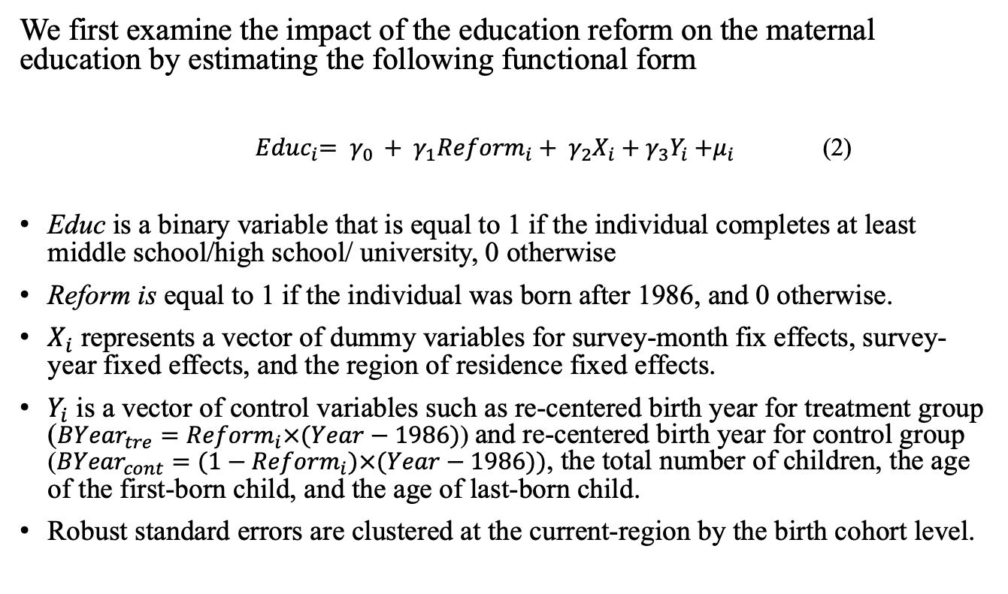
IDENTIFICATION
We first examine the impact of the education reform on the maternal education by estimating the following functional form
${ Educ}_{i}= γ_{0 }+ γ_{1}{Reform}_{i}+ γ_{2}X_{i}+γ_{3}Y_{i}{+μ}_{i}$ (2)
Educ is a binary variable that is equal to 1 if the individual completes at least middle school/high school/ university, 0 otherwise
Reform is equal to 1 if the individual was born after 1986, and 0 otherwise.
$X_{i}$ represents a vector of dummy variables for survey-month fix effects, survey-year fixed effects, and the region of residence fixed effects.
$Y_{i}$ is a vector of control variables such as re-centered birth year for treatment group (${{BYear}_{tre}=Reform}_{i}×(Year−1986)$) and re-centered birth year for control group (${{BYear}_{cont}=(1−Reform}_{i})×(Year−1986))$, the total number of children, the age of the first-born child, and the age of last-born child.
Robust standard errors are clustered at the current-region by the birth cohort level.
Table

Slide 11
Why we use Reduced Form
Regression design?
The possible violation of exclusion restriction assumption of the Fuzzy RDD:
  an increase in schooling level may influence women’s propensity to marry with higher educated men by changing their preferences for marriage
  misreporting of birth month in Turkey
Table

Slide 12
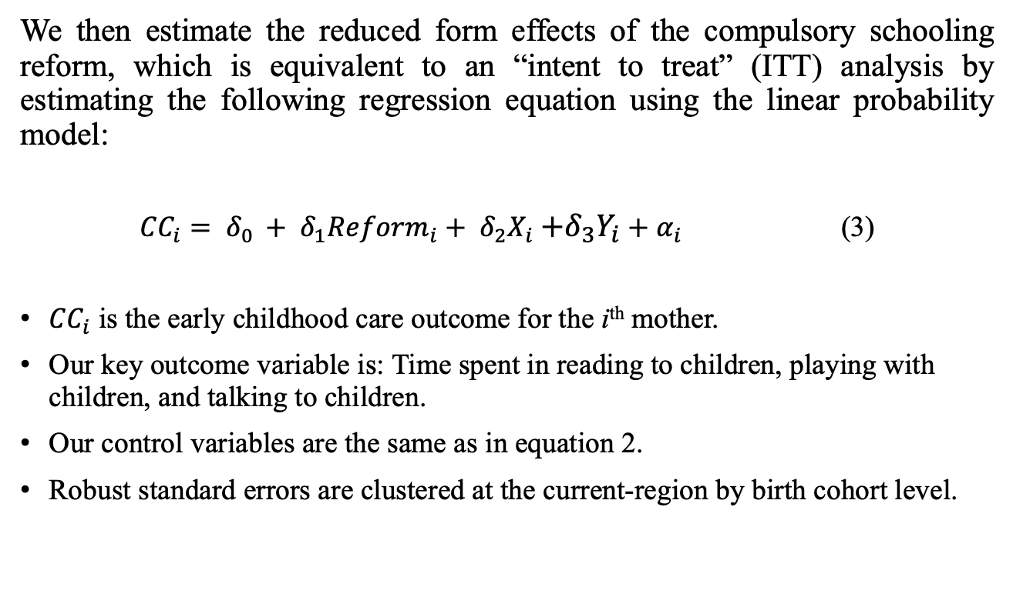
IDENTIFICATION (cont’d)
We then estimate the reduced form effects of the compulsory schooling reform, which is equivalent to an “intent to treat” (ITT) analysis by estimating the following regression equation using the linear probability model:
${CC}_{i}= δ_{0 }+ δ_{1}{Reform}_{i}+ δ_{2}X_{i}{+δ_{3}Y_{i}+α}_{i}$ (3)
${CC}_{i}$ is the early childhood care outcome for the i^{th} mother.
Our key outcome variable is: Time spent in reading to children, playing with children, and talking to children.
Our control variables are the same as in equation 2.
Robust standard errors are clustered at the current-region by birth cohort level.

Slide 13
RESULTS
Descriptive Statistics
Preliminary Checks: Impact of Reform on Sample Selection and Fertility
Main Results
  Schooling Outcomes
  Time Spent on Early Childhood Care
  Time Spent in Activities Accompanied by Children

Slide 14
DESCRIPTIVE STATISTICS
Figure 1. Proportion of Mothers with At Least Middle School Diploma in 2014-2015 by Birth Cohorts 1980 to 1992
Figure 2. Average Time Spent in Playing with Children, Reading and Talking to Children (in min. per week) by Birth Cohorts 1980 to 1992
Figure 3. Average Proportion of Individuals Playing with Children, Reading and Talking to Children by Birth Cohorts 1980 to 1992

Slide 15
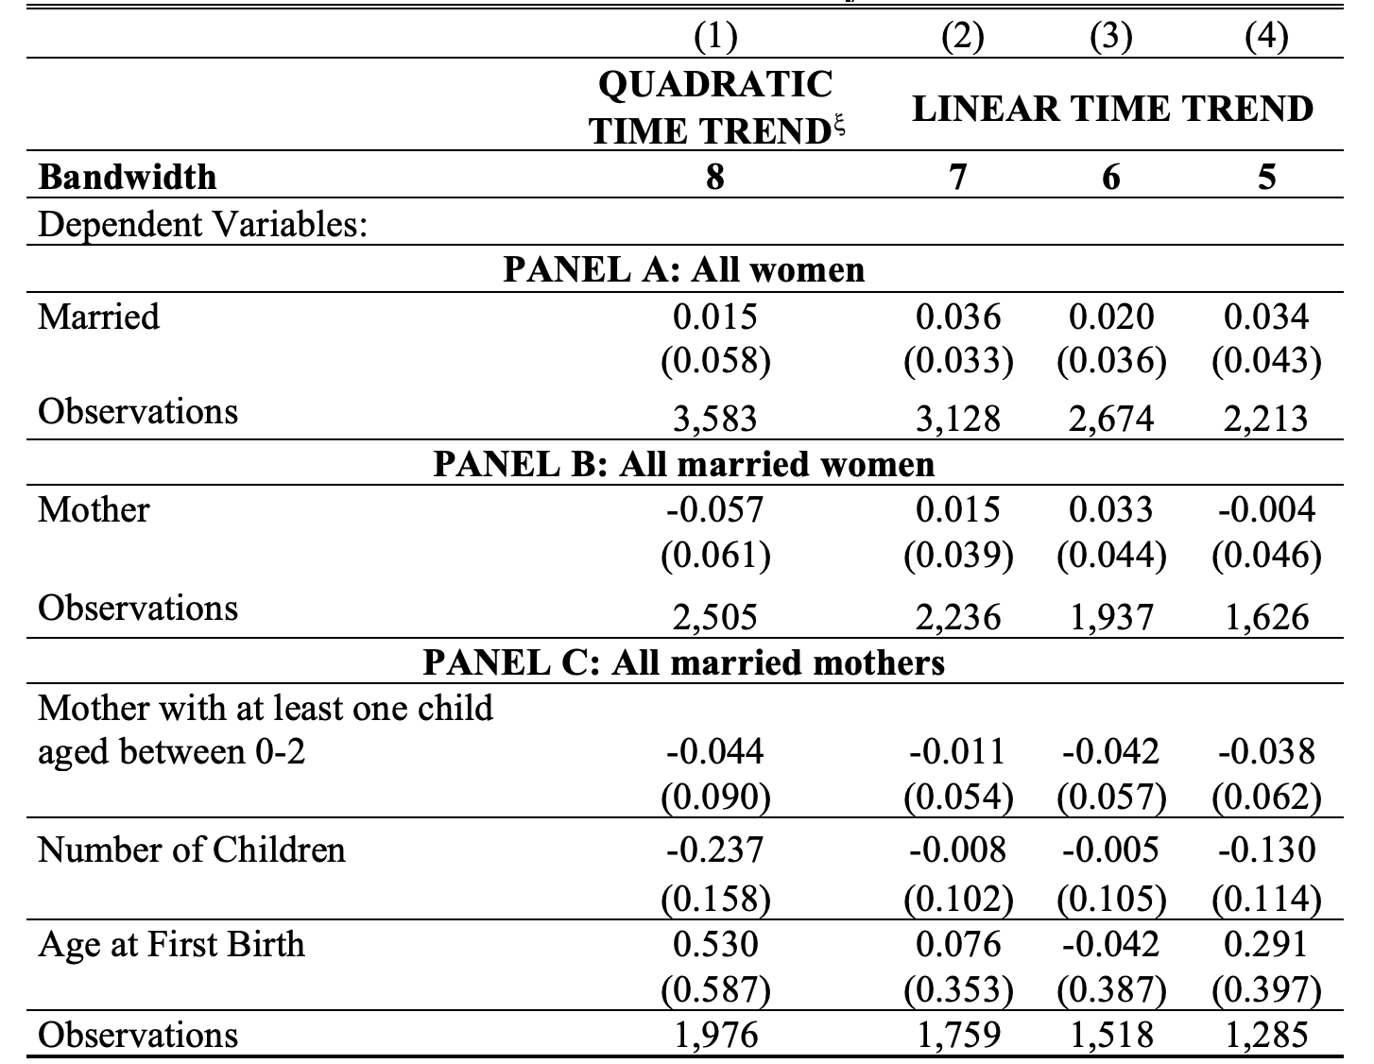
The Impact of Exposure to the Education Reform on Sample Selection and Fertility

Slide 16
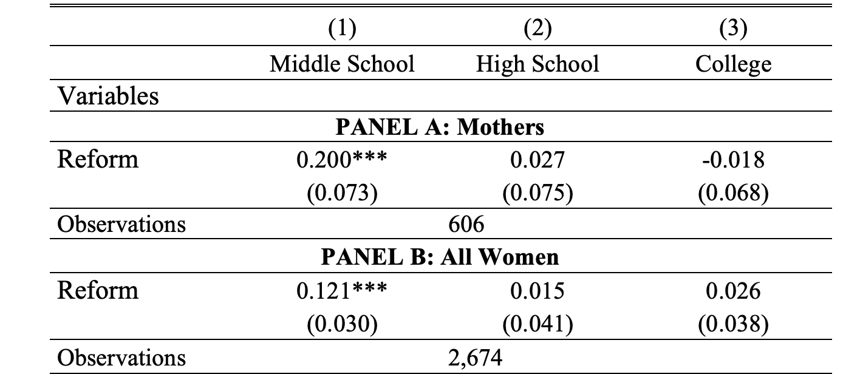
The Impact of Exposure to the Education Reform on Educational Outcomes

Slide 17
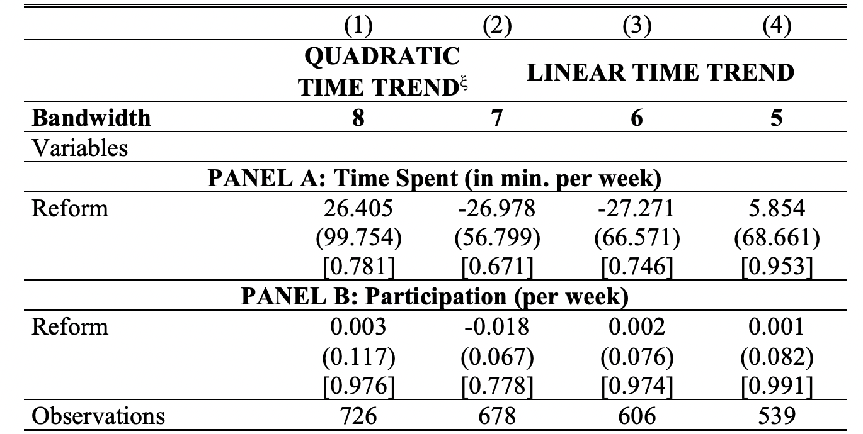
The Impact of Exposure to the Education Reform on Early Childhood Care Outcomes

Slide 18
POTENTIAL MECHANISM
No impact of the education reform on mothers’ probability of being employed and earning higher than minimum wage as well as working hours.
Restricting the sample to stay-at-home mothers does not change our main findings.
No impact of mothers’ education on husband’s early childhood care time.
Negative impact of the education reform on time spent in supervisory activities, other unspecified child care activities, and travelling with children but no impact of the reform on time spent in physical activities.
Table
Table
Table
Table

Slide 19
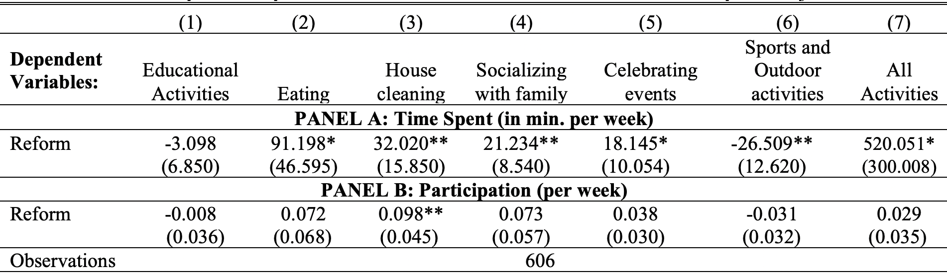
The Impact of Exposure to the Education Reform on Activities Accompanied by Children

Slide 20
RESULTS
Increased education had no impact on time spent in early childhood care.
There is a positive association between education and time spent in early childhood care activities.
The positive association between time spent in early childhood care and mother’s education is probably due to the omitted variable bias, as individual characteristics and family characteristics may influence both early childhood care and maternal educational attainment.
The extension of three years at the secondary school level has no impact on time spent in early childhood care and increased education at higher levels such as tertiary education attainment may affect time spent in early childhood education.
Table

Slide 21
ROBUSTNESS CHECK:
Placebo test
Alternative Sample Specifications
  Including 1986 birth cohort
  Restricting the sample to those who do not receive child care from others
  Restricting the sample to mothers who have at least one child aged 0-2 but not have a child older than 9
  Restricting the sample to mothers who have at least one child aged 0-4 and 0-6
Alternative Model Specifications
  Clustering standard errors at birth cohort by survey year (Estimating the p-values using wild cluster bootstrap )
Table
Table
Table
Table

Slide 22
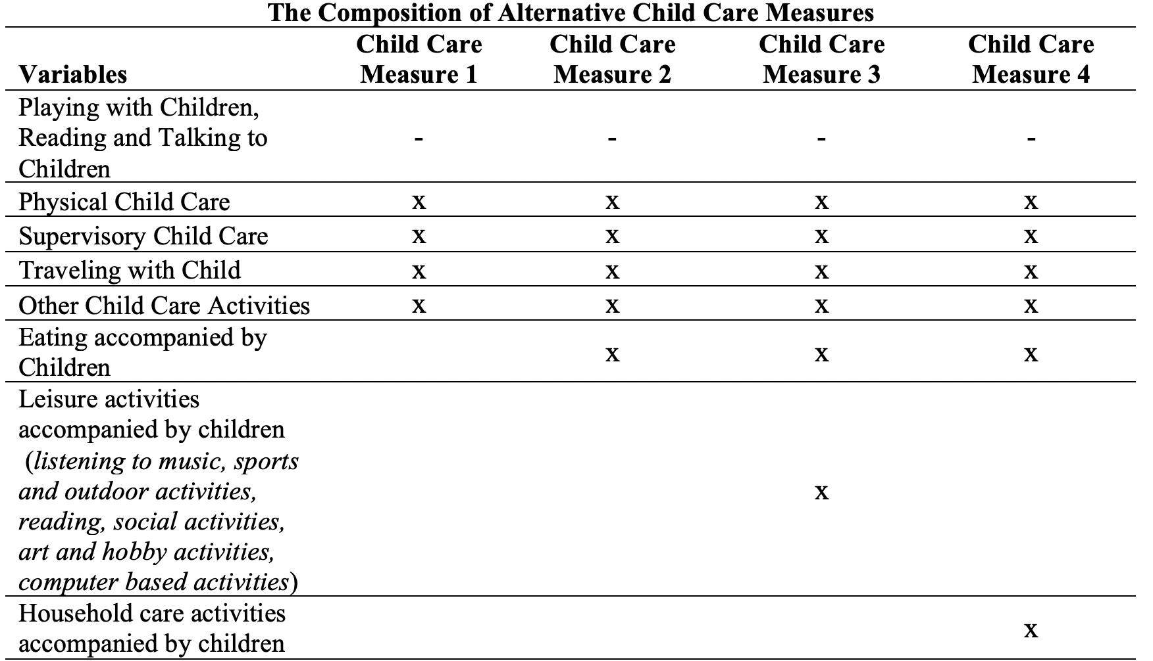
REVISITING USTA (2020) with Turkish TUS

Slide 23
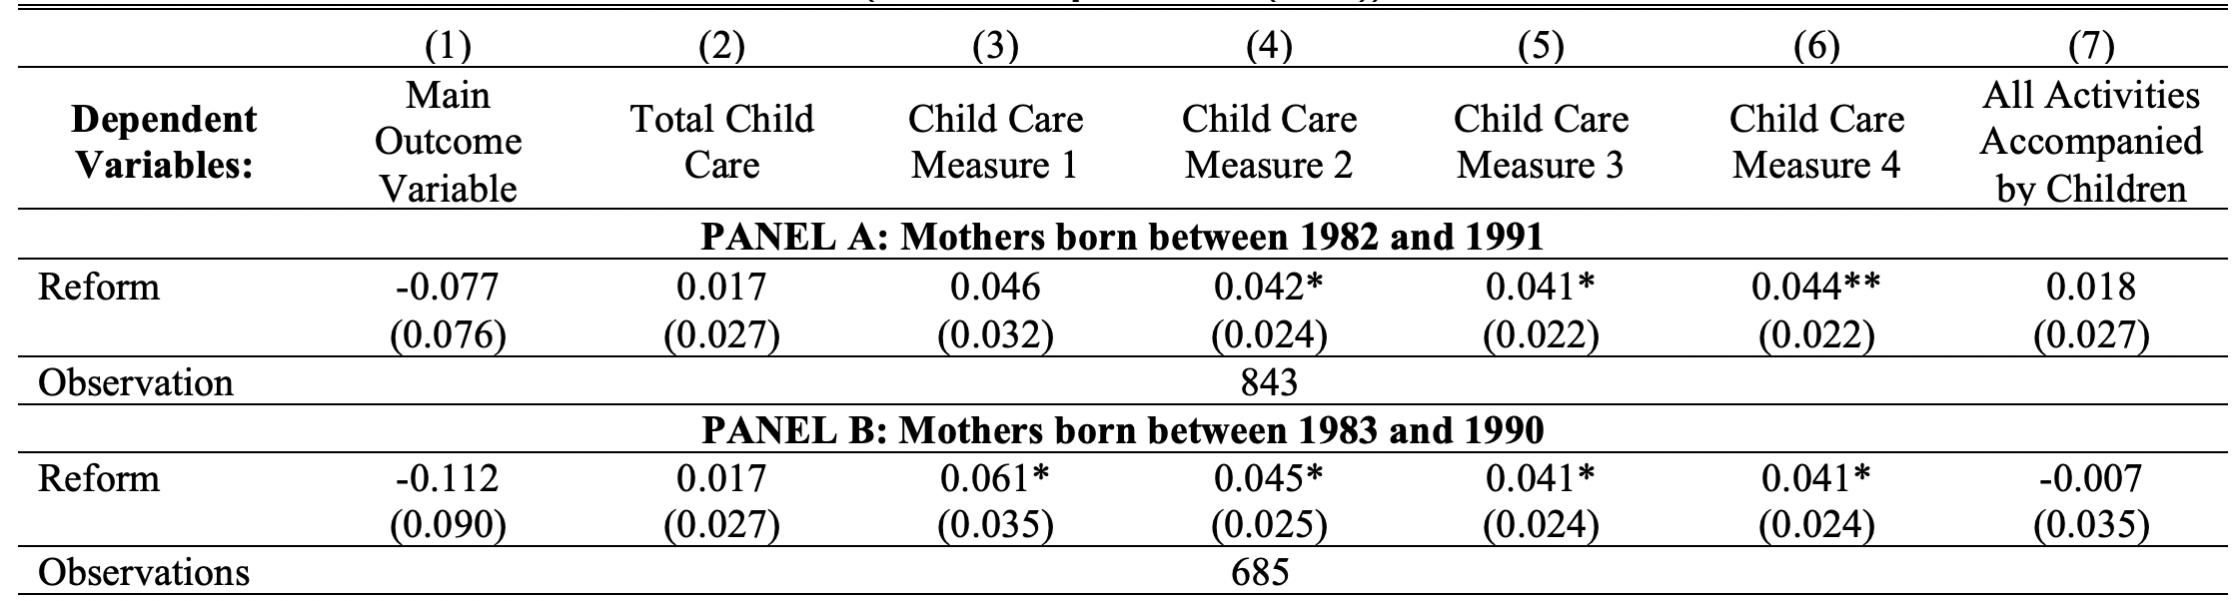
REVISITING USTA (2020) with Turkish TUS

Slide 24
CONCLUSION
Although the reform increases time spent in other daily activities accompanied by children, it has no impact on the quality of time spent with children as time spent in reading to children, playing with children, talking to children does not change.
In order to abridge the gap between rich and poor in terms of exposure to early childhood education, a more free and fair access to formal early childhood education and care deserves the attention of policy makers.

Slide 25
APPENDIX

Slide 26
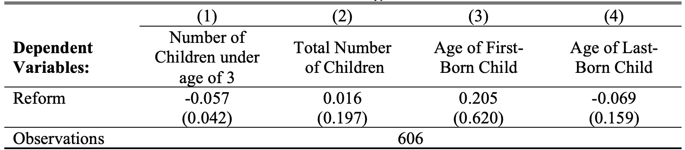
The Impact of Exposure to the Education Reform on the Number of Children and the Age of Child
Back

Slide 27
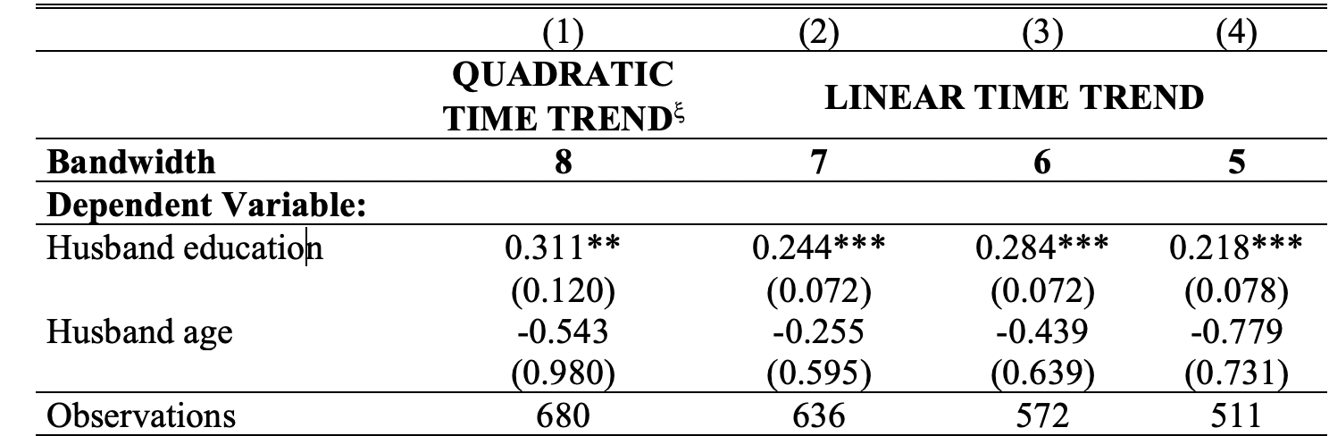
The Impact of Education Reform on Husband’s Characteristics
Back

Slide 28
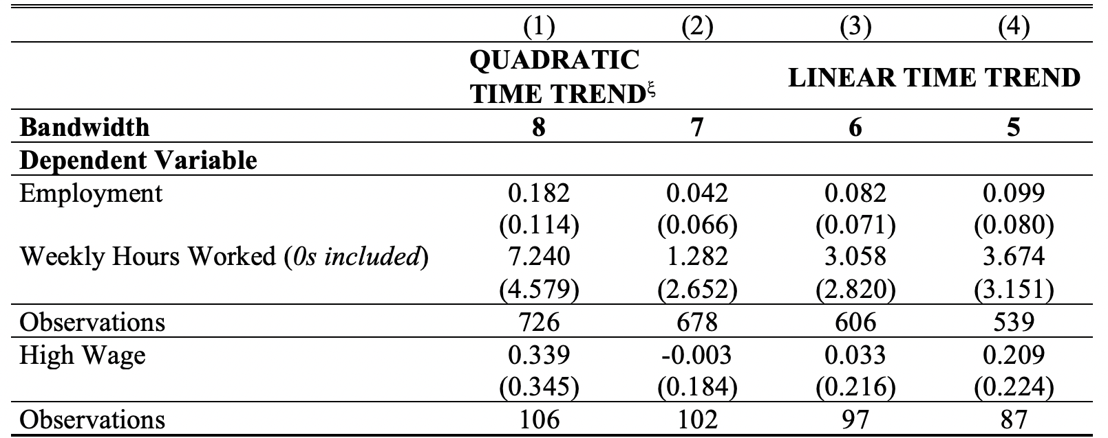
The Impact of Exposure to the Education Reform on Labor Market Outcomes of Mothers
Back

Slide 29
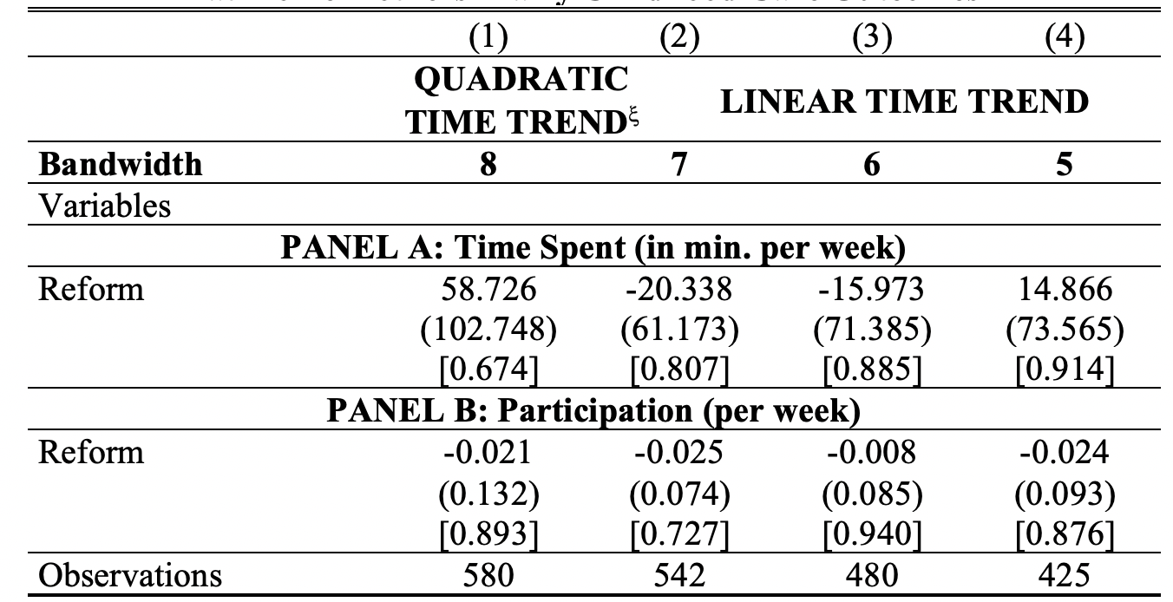
The Impact of Exposure to the Education Reform on Stay-at-Home mothers’ Early Childhood Care Outcomes
Back

Slide 30
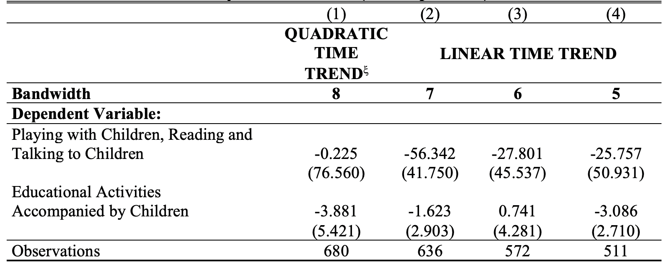
The Impact of Exposure to the Education Reform on Husband’s Time Spent in Early Childhood Care (in min. per week)
Back

Slide 31
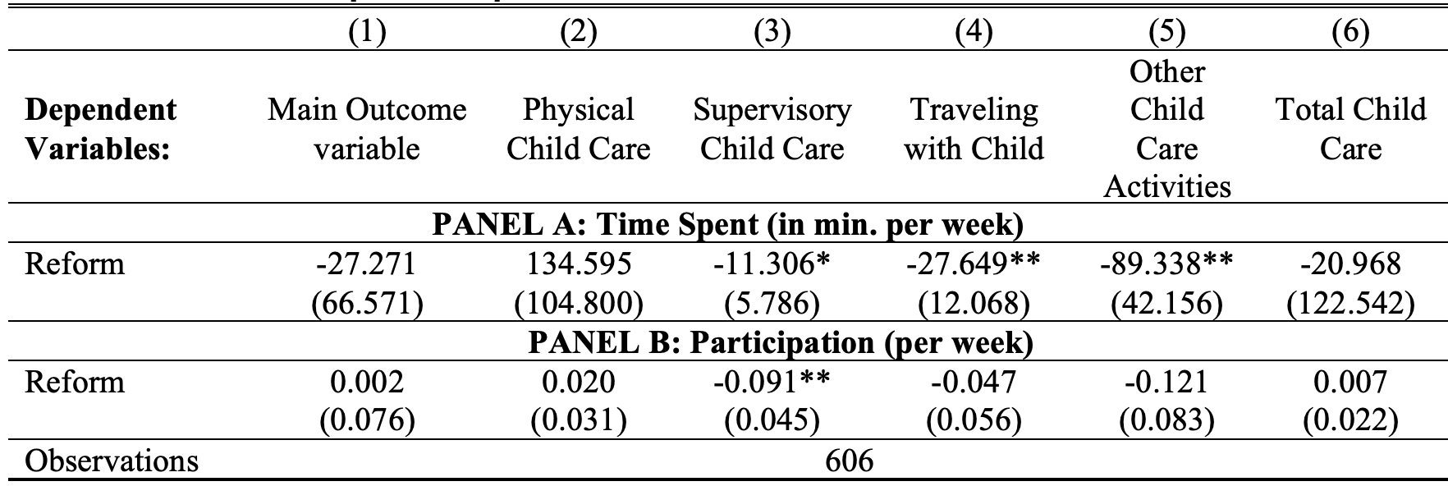
The Impact of Exposure to the Education Reform on Other Child Care Outcomes
Back

Slide 32
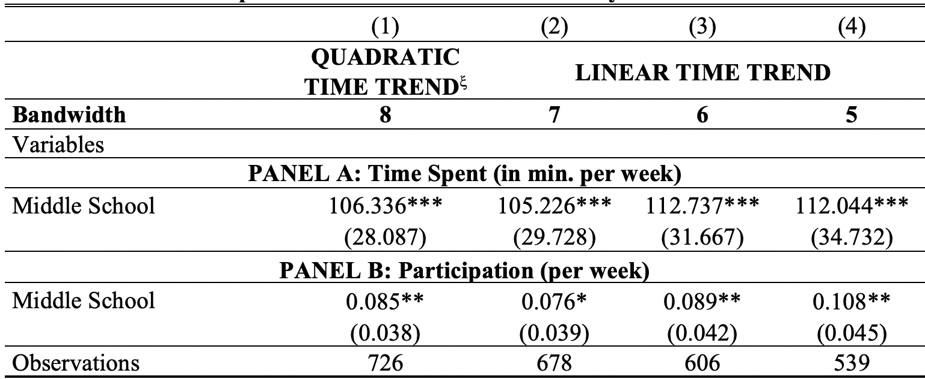
The Impact of Maternal Education on Early Childhood Care Outcomes-OLS regressions
Back

Slide 33
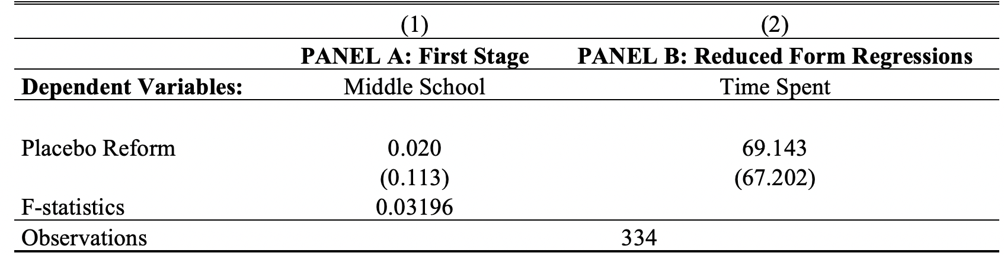
Placebo test
Back

Slide 34
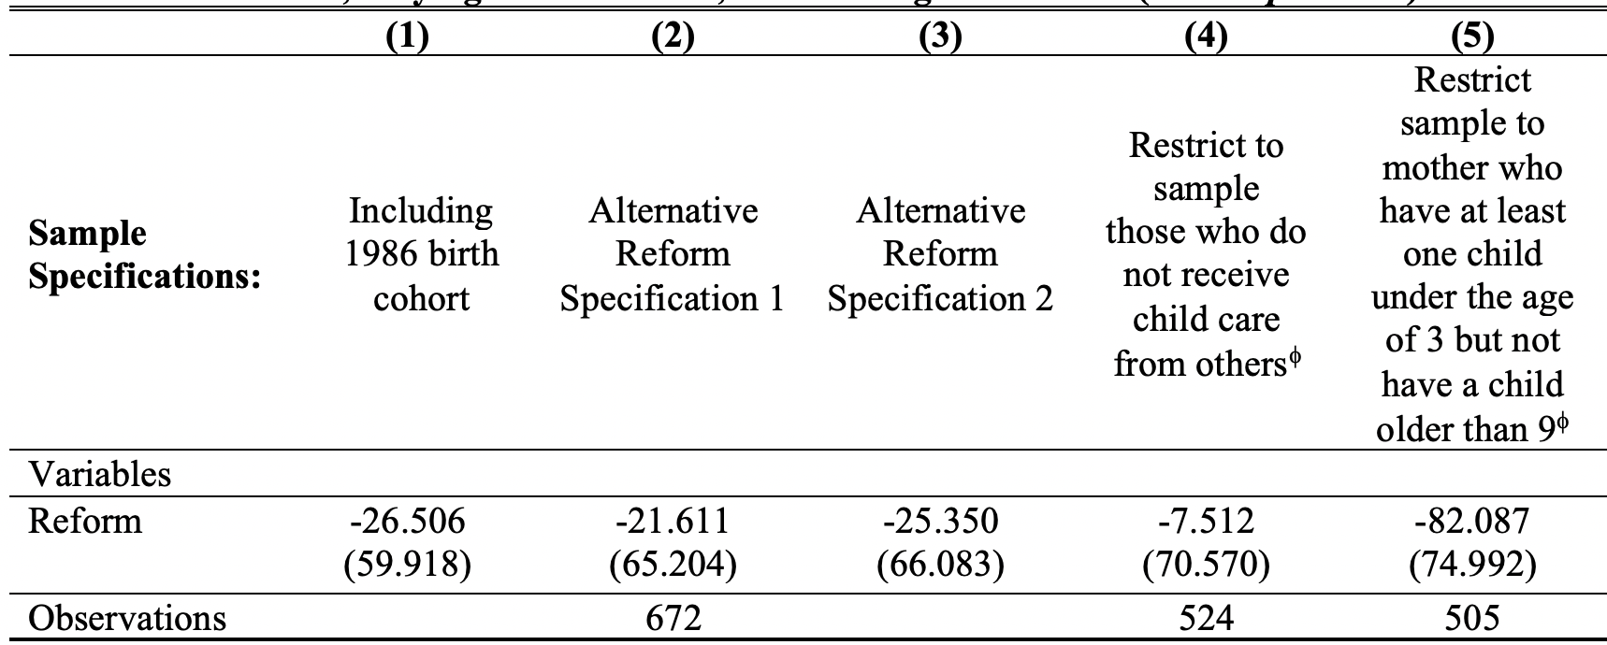
Robustness check 1
Back

Slide 35
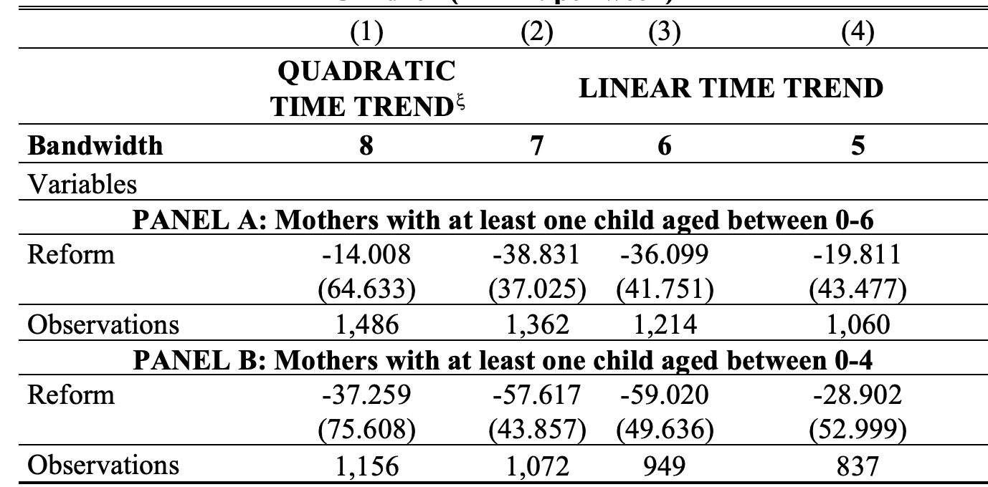
Robustness check 2
Back

